Slide 1
URBiNAT meeting Sofia, 23.01.2019 Sofia Municipality – District“Nadezhda”

Slide 2
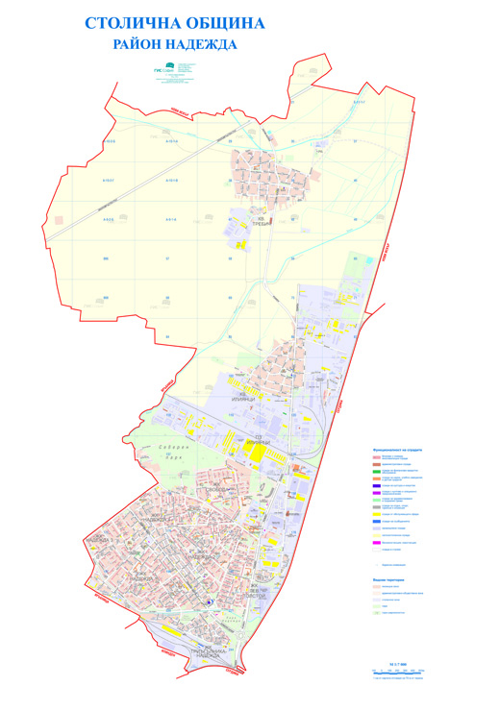
- one of the oldest districts of the city
- located on an area of ​​19,300 acres
- 12 municipal kindergartens - 9 public schools - 6 social services – crisis center, community centers, day care center for children with disabilities - 4 private schools - MCI (Municipal Cultural Institute “Nadezhda”) - center for artistic, cultural and educational activities
- 4 cultural organizations - Stadium “Lokomotiv” - North Park

Slide 3
activities in the sphere of innovation, landscaping, ecology, enrichment and improvement of the quality of life in the area

Slide 4
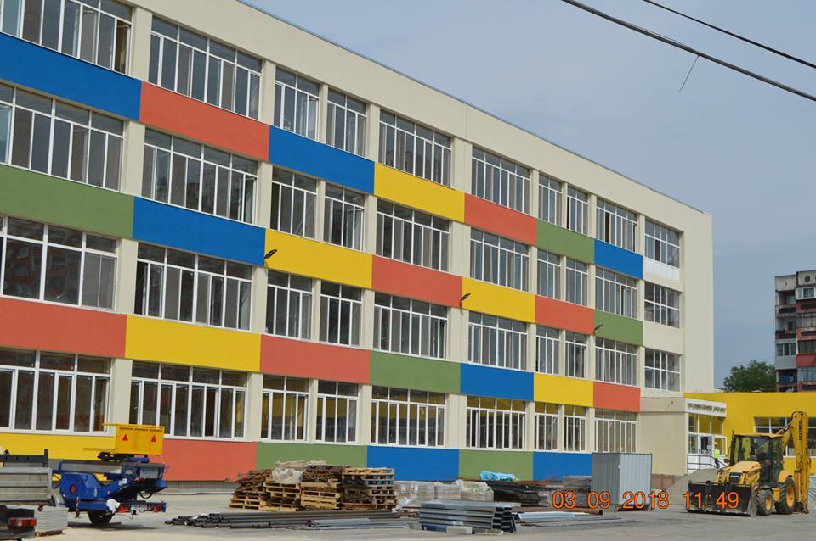
an integrated urban regeneration and development plan
101 MIDDLE SCHOOL
BEFORE
101 MIDDLE SCHOOL AFTER

Slide 5
an integrated urban regeneration and development plan
16 MAIN SCHOOL BEFORE
16 MAIN SCHOOL AFTER

Slide 6
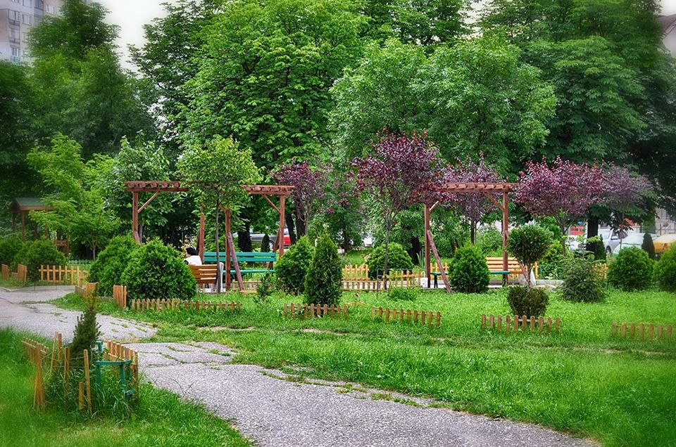
Project Green Sofia. landscaping and maintenance of park spaces.

Slide 7
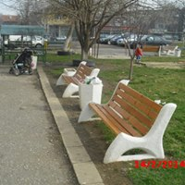
Project Green Sofia. landscaping and maintenance of park spaces.

Slide 8
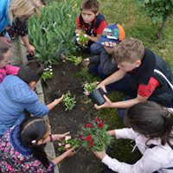
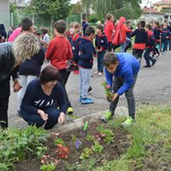
experimental fields in kindergartens and schools. afforestation, planting and growing of vegetation.

Slide 9
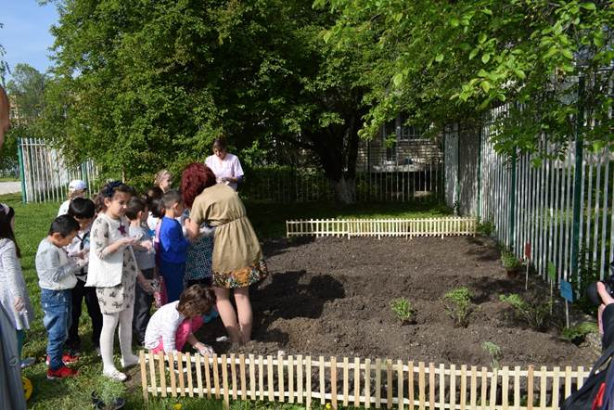
experimental fields in kindergartens and schools. afforestation, planting and growing of vegetation.

Slide 10
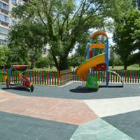
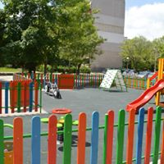
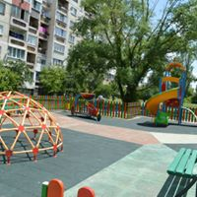
construction of playgrounds. separation of park spaces for dogs.

Slide 11
Projects: - Benefit As you Save – BAS Stimulating citizens participation to recycle processes - Build Solid Ground volunteer initiative of civil society. national policies and good practices for sustainable urban development

Slide 12
building the first salty room in the kindergarten in the country

Slide 13
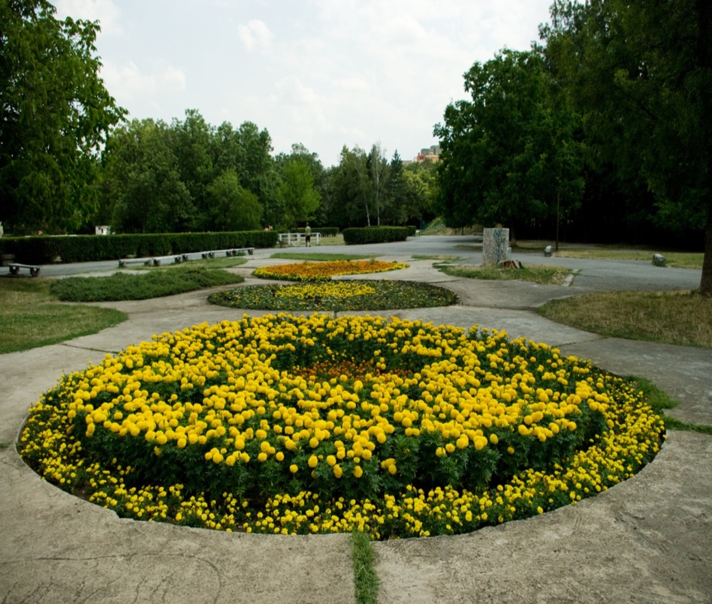
NORTH PARK

Slide 14
NORTH PARK

Slide 15
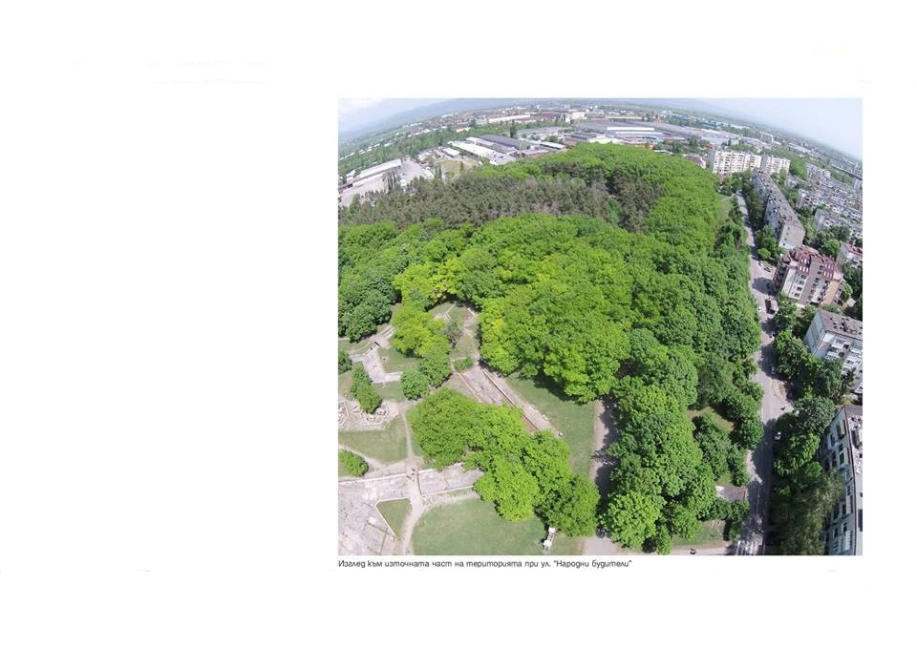
THANK YOU FOR YOUR ATTENTION
URBiNAT meeting, Sofia, 23.01.2019

